Slide 1


TEC++US 2.0

Slide 2

Presentation
20 minutes:
Informations about the training and procedures to use during the training programe, brakes, presence and atendance.
40 minutes:
Presentation of the trainer and trainees (Name, institution, motivations, other informations)
Any information in english that can´t be translated (like online vídeos that aren´t property of the trainers) will be translated live.

Slide 3
Naš cilj
Piktografski poliglot
v žepu!

Slide 4

Projekt TEC++US 2.0 je razvit v okviru programa ERASMUS+ in sofinanciran s strani EU.
Je nadaljevanje TEC++US projekta, ki se je odvijal med letoma 2018 in 2020.

Slide 5

1. Razumevanje vključujočega izobraževanja

Slide 6


Prosimo, bodite pozorni na video!
https://www.youtube.com/watch?v=BO1Nae_EBvQ

Slide 7


Ste v tej rock skupini opazili kaj posebnega?

Slide 8

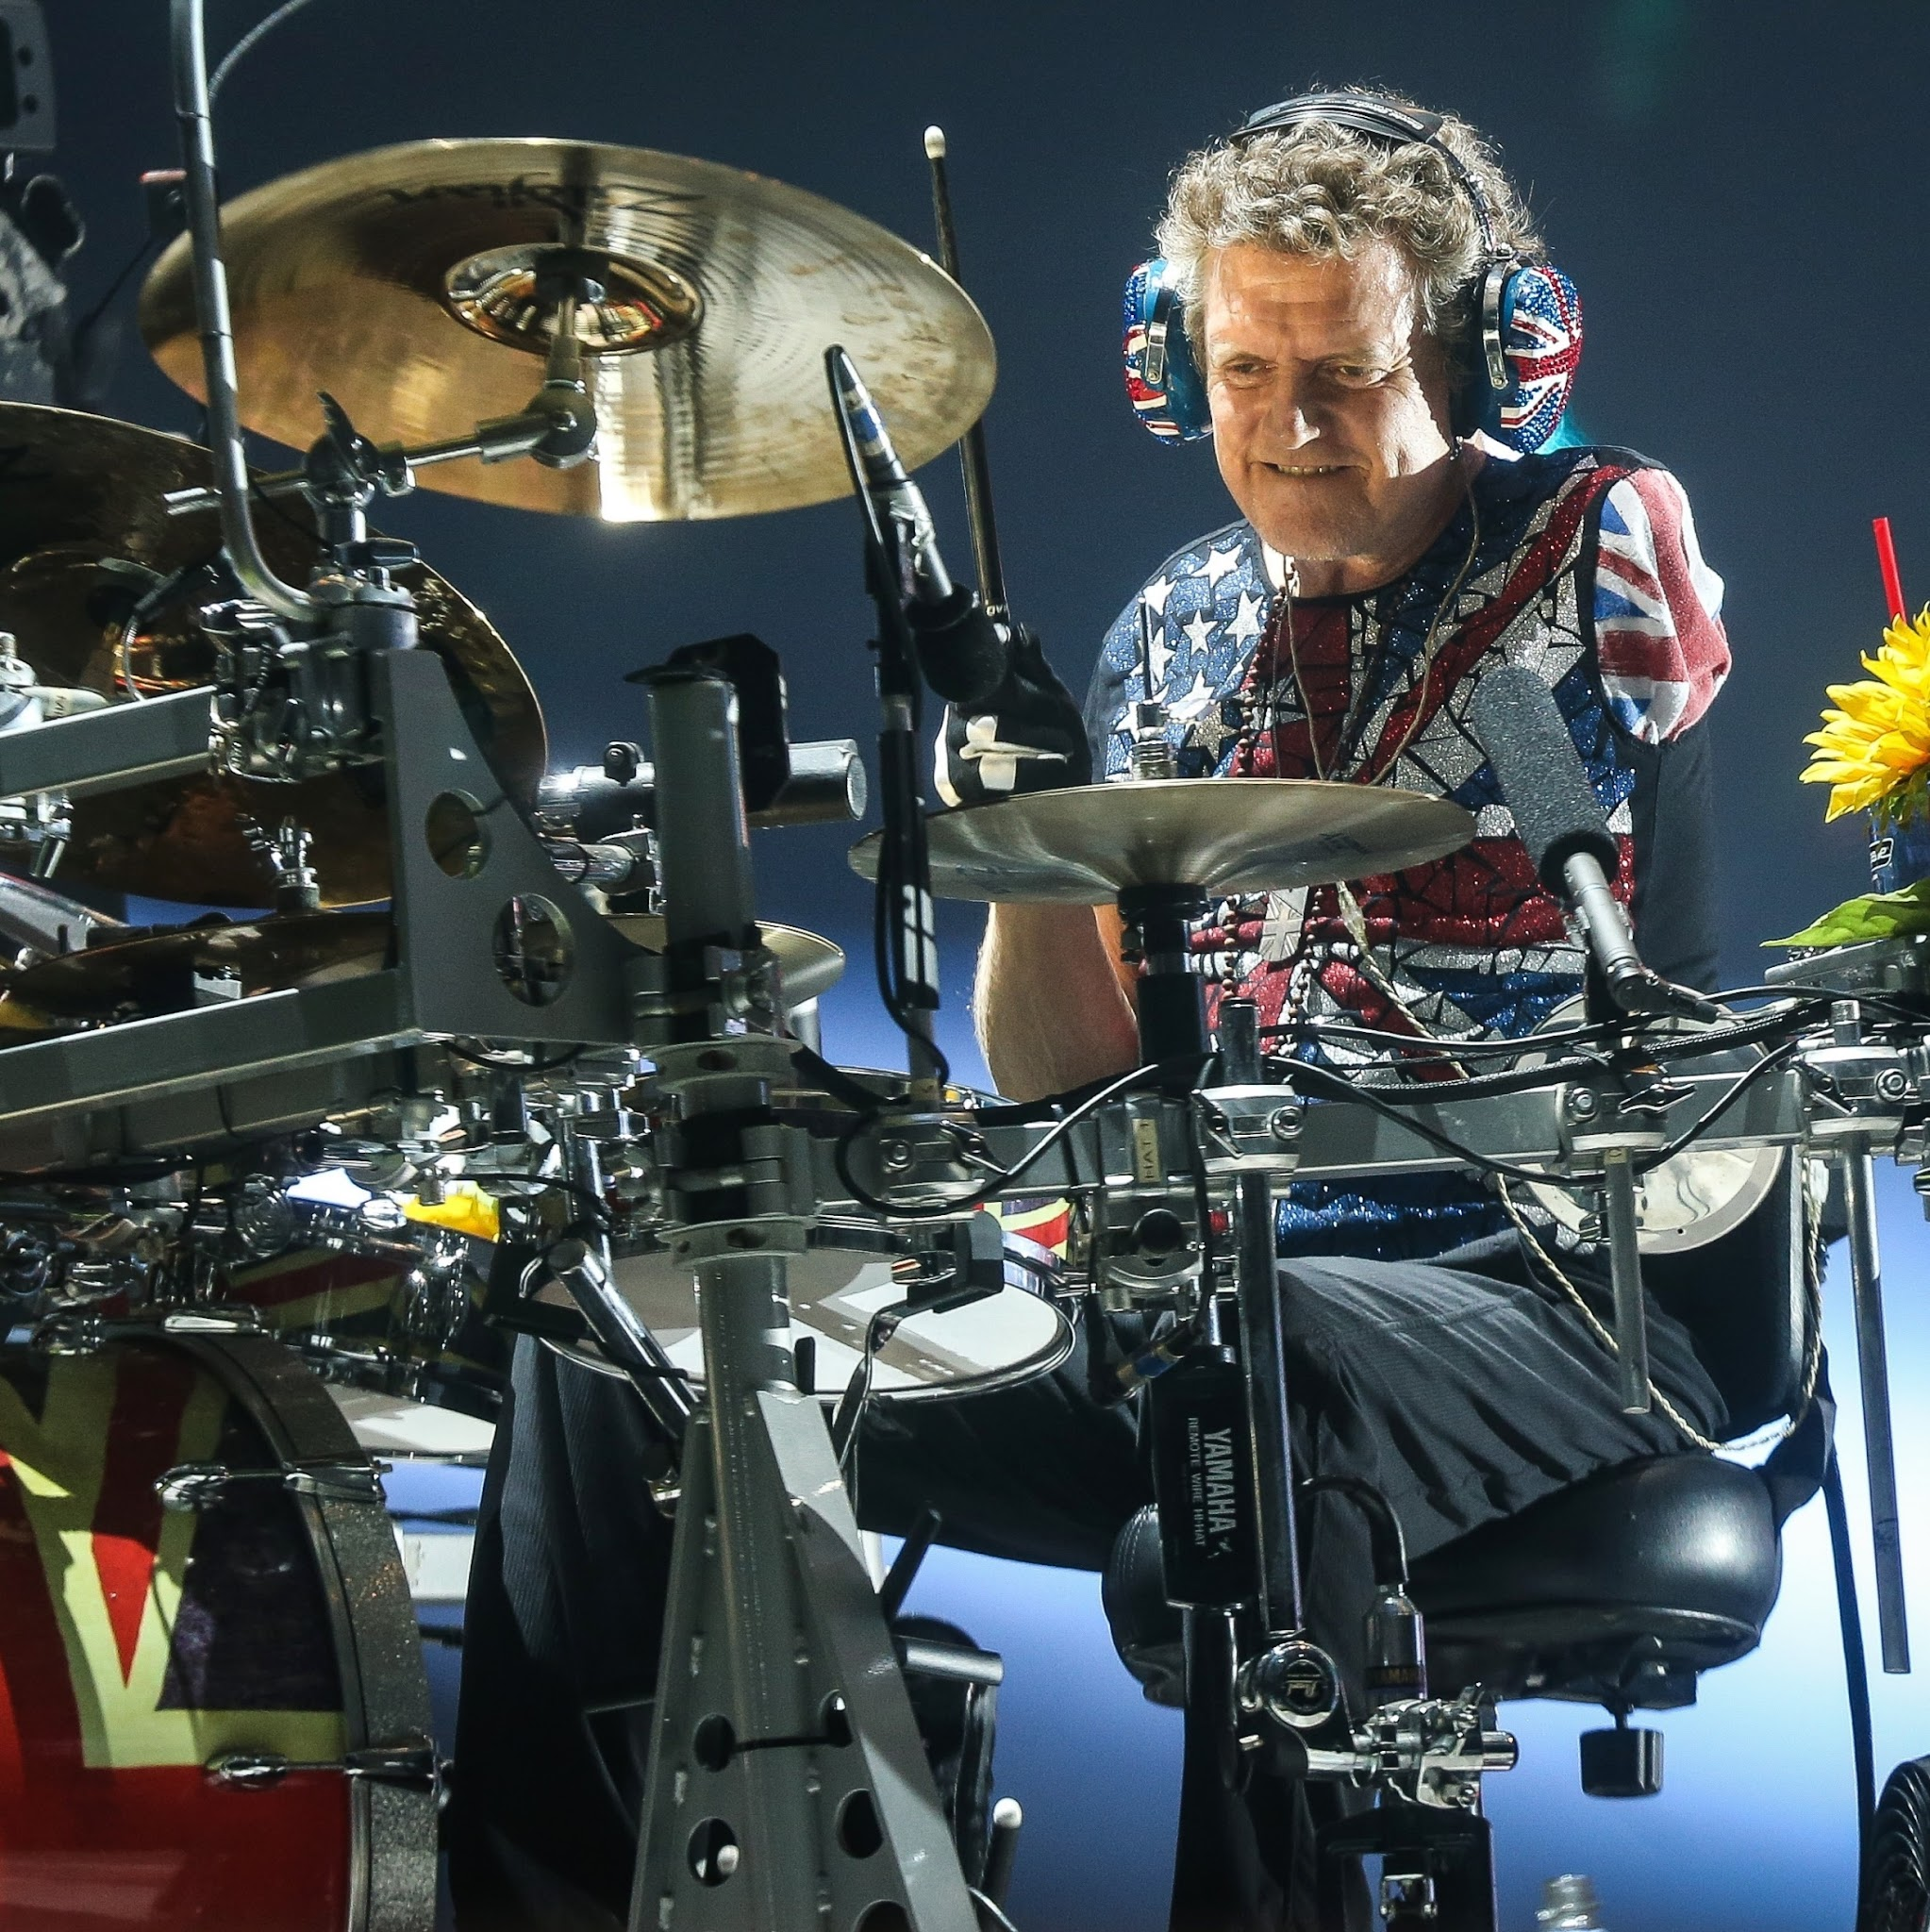
Def Leppard
Richard John Cyril Allen (rojen 1. novembra 1963) je angleški bobnar, ki je od leta 1978 igral v hard rock skupini Def Leppard. Januarja 1985 je prebolel amputacijo leve roke in nadaljeval z igranjem v skupini, ki je od tedaj naprej nadaljevala v svojo najuspešnejšo fazo. (na Wikipediji)

Slide 9


VKLJUČEVANJE

Slide 10
Tony Booth sodelovanje v vključujoči učilnici opisuje takole:
[...] Pomeni učenje skupaj z drugimi in sodelovanje z njimi v skupnih razredih. Vključuje aktiven kompromis z naučenim in poučenim ter besedo o tem, kako se izobraževanje doživlja. Sodelovati pa pomeni tudi biti prepoznan in sprejet s strani sebe: sodelujem s teboj, ko me prepoznaš kot osebo, kot si ti, in me sprejmeš takšno, kot sem.
(Booth 2003:2)

Slide 11

How did we get here?
1940… še vedno obstajajo centri za ljudi s posebnimi potrebami
Sprememba filozofije inkluzivnega izobraževanja
V 60ih letih:
Združenja prvih staršev;
Humanistične perspektive s poudarkom na Deklaraciji o otrokovih pravicah in človekovih pravicah;
…

Slide 12
Od normalizacije do vključitve:
Vidiki, ki so prispevali k vprašanju institucionalizacije ljudi s posebnimi potrebami:
razvoj združenj staršev;
ljudje s posebnimi potrebami in prostovoljci;
zavedanje družbe o dehumanizaciji številnih institucij;
nizka kakovost storitev v teh institucijah; visoki ekonomski stroški …
Pravice otrok in mladih s posebnimi potrebami, ki že zagotavljajo pravico do izobraževanja, enakih možnosti in sodelovanja v družbi.

Slide 13
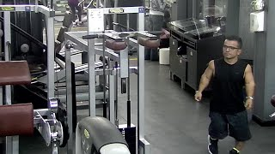
Usposabljanje, ki spreminja mnenja
https://www.youtube.com/watch?v=1b4PvmMCy2Y&t=3s

Slide 14
EVOLUCIJA
Razvoj medicinskega/predpisnega v socialni model
Pogled, osredotočen na težave učencev
Perspektiva, osredotočena na globalno situacijo poučevanja in učenja
Privilegirana uporaba specialistov kot agentov izobraževalne intervencije
Pogled, osredotočen na pedagogiko kot agenta sprememb

Slide 15
EVOLUCIJA
Evolution of the medical/prescriptive to a social model
Separation of students in categories distinctively labelled and then grouped supposedly in a homogeneous way
Individualization of teaching in heterogeneous groups
Generalized use
of separated spaces
Educational spaces used by the general students

Slide 16
EVOLUTION
Evolution of the medical/prescriptive to a social model
Radical distinction between the students’ with Special needs and the rest
No to compartmentalization of students in closed groups; any student, at any time can need individualized support

Slide 17
EVOLUTION
Looking to achieve an education that grants simultaneously the principles of “equity” and “quality”.
Promoting the development of Educational and Curricular projects based in inclusion.
Developing a school for everyone in which the supporting systems, being internal or external to school, increase its competence for an effective response to the diversity of students
Potentiating the teaching/ learning process in an active perspective.
Promoting the participation of all students in the activities inside the classroom and in the extra-school scope.

Slide 18
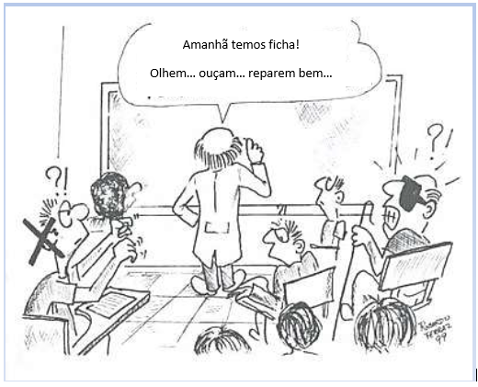
Tomorrow we are having a test…
Listen… Look… notice …

Slide 19
Online
Asynchronous Activity
Try some multimedia tools that may be conducive to the application of active methodologies
Plikers https://get.plickers.com/
Mentimeter https://www.mentimeter.com/
Padlet https://padlet.com/
GoConqr https://www.goconqr.com/

Slide 20
2. Gardner's Theory of multiple intelligences.

Slide 21
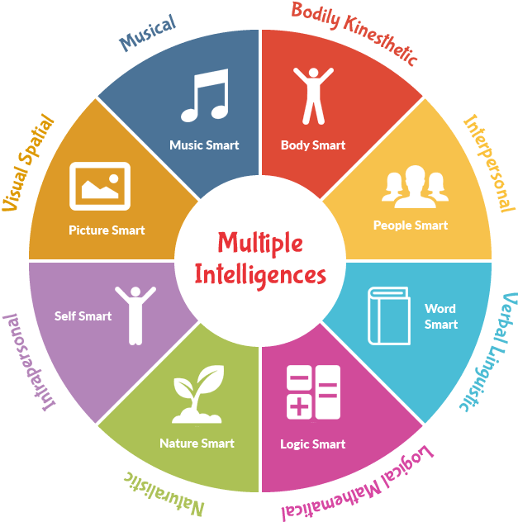
Multiple Intelligence Theory

Slide 22
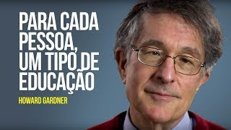
Multiple Intelligence Theory
https://www.youtube.com/watch?v=tLHrC1ISPXE

Slide 23
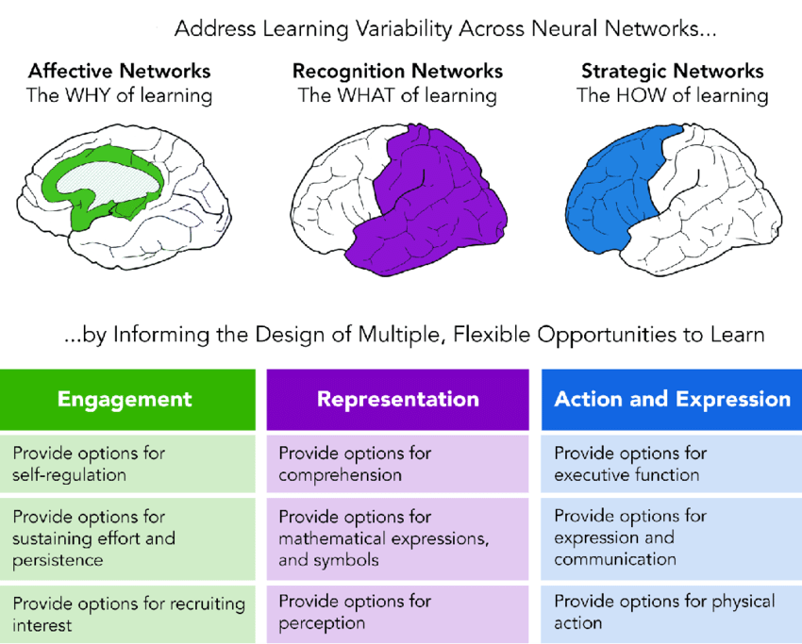
UDL
Universal Design in Learning

Slide 24

UDL: Principles and Practice
https://www.youtube.com/watch?v=pGLTJw0GSxk

Slide 25
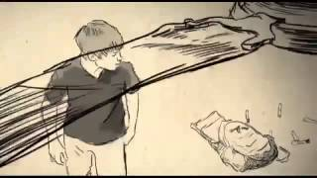
How the world is perceived by a person with autism
https://youtu.be/GaRu2gBLhec

Slide 26
Examples of active methodologies
1. Problem Based Learning (PBL)
2. Hybrid Teaching
3. Case study
4. Gamification
5. “Hands on”
6. Inverted classroom
Activity (60 min) – In groups choose one of the methodologies, make a research about it with your small group, debate the prós and cons of the methodologie to make a presentation to the large group about your group opinion.

Slide 27
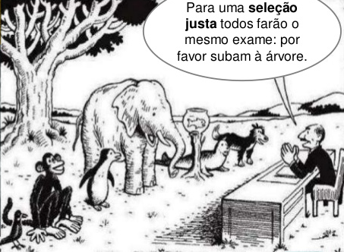
Traditional Education System
For a fair selection, everyone will do the same test: Please, climb the tree.…

Slide 28
Asynchronous Activity
After the training make this multiple intelegences test and aplly it in your classroom to set the best learning path to your students.
https://www.idrlabs.com/pt/inteligencias-multiplas/teste.php

Slide 29
3. Presentation of pictograms and the TEC++US app

Slide 30
Technology from Everyone to Each and Everyone of Us 2.0 - TEC++US 2.0 - was founded under the ERASMUS+ Project and emerges from the EU Commission's strategy. It has the main objective of developing tools that inspires itself in the universal philosophy principle of overpassing intercultural barriers of communication.

Slide 31
LANGUAGE
A system of signs that allows the construction of an interpretation of reality through sounds, letters, colors, images, gestures, etc.

Slide 32
Our primary objective was to create a transnational tool, which facilitates the learning of useful basic words/expressions/questions to kids, during the first week of adaptation to a new country, or in acquiring language skills in basic school.
The European Pictographic Communication Language Translator (TEC++US App) – Available to android and iOS operational system.

Slide 33
Our Goals
To make the difference for children and young people in language learning and inclusion in classroom;
To improve even more the acceptance of digital inclusion in classroom (physical or online) with the ECPL and EPCL Translator;
To improve teachers and educators skills with educational support materials that will be created to create an easy approach to the universal designed classroom,with tutorials, worksheets, online material and others.

Slide 34
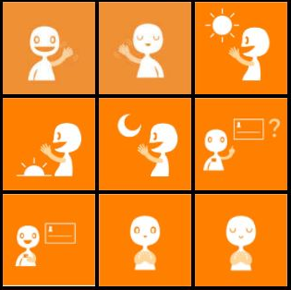
Pictograms-An essential tool for children with special needs
Pictograms are drawings or pictures that clearly represent an action or abstract concept.
In general, pictograms are used temporarily to help children structure their routine, understand rules and organize other parts of their lives.
With children who have special needs, pictograms are very useful.

Slide 35
European Pictogram Communication Language (EPCL).
Pictographic system used to simplify communication
https://www.tec4everyone2us.eu/categories

Slide 36
Why are our pictograms more effective?
Some of these programs use 28 000 pictograms
They are too complicated to use
Too much detail is a weak point when looking for quick info

Slide 37
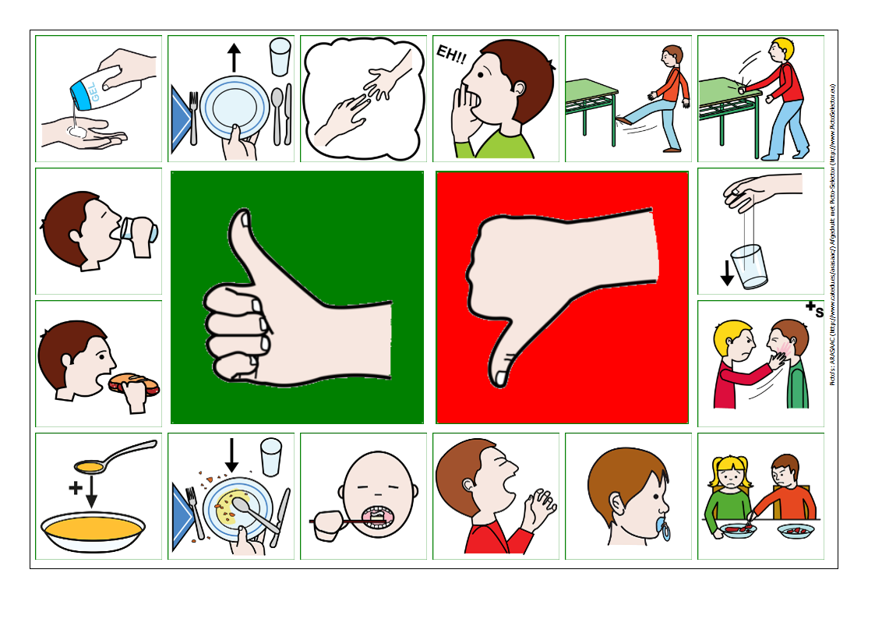
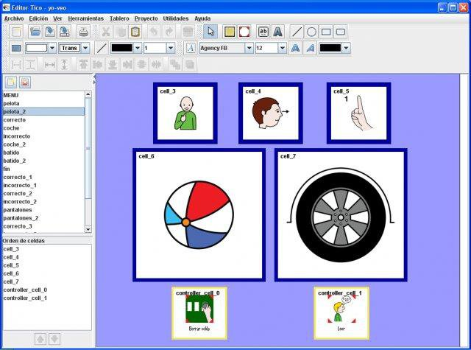
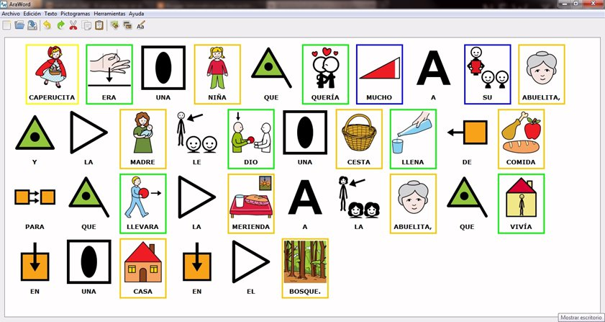
Other pictograms software examples

Slide 38





Normal way of communicating with symbols
Can you call the teacher?

Slide 39

TEC++US communication with symbols
Can you cal the teacher?

Slide 40

It is expected that after a week using the TEC++US App that the user will acquire more vocabulary than what is available in the application, by the simple fact that individuals will enter into active conversation with other individuals with the help of the application and that they will associate the available words more quickly.

Slide 41


The App
Homepage
Search in your phone and install TEC++US 2.0 App.
Link to Google Play (Android):
https://play.google.com/store/apps/details?id=com.Erasmus.TECUS
Link to Play Store (IOS):
https://apps.apple.com/pt/app/tec-us2-0/id6452801084?l=en-GB

Slide 42

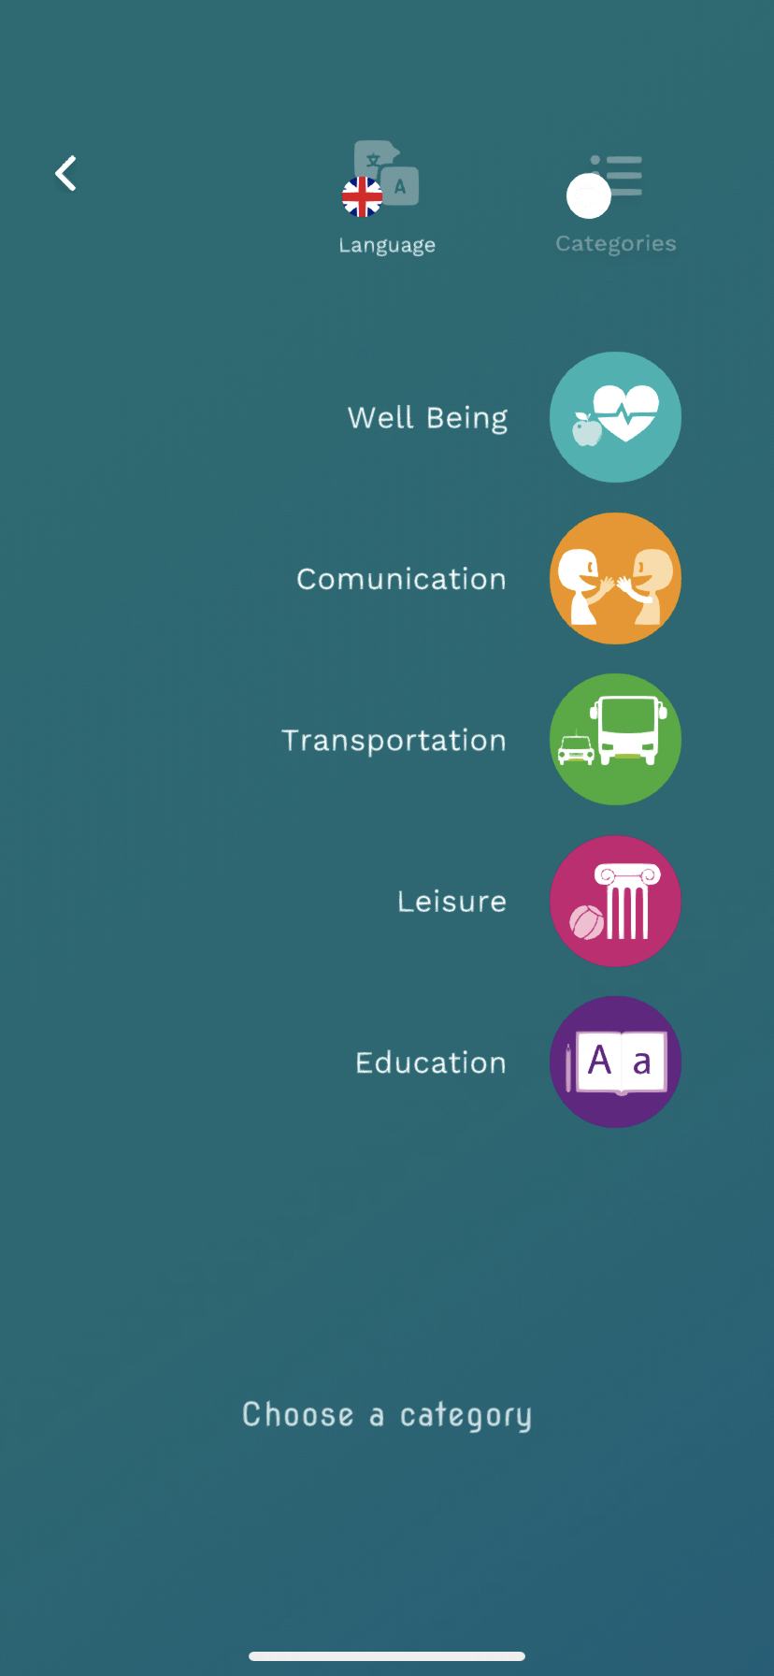
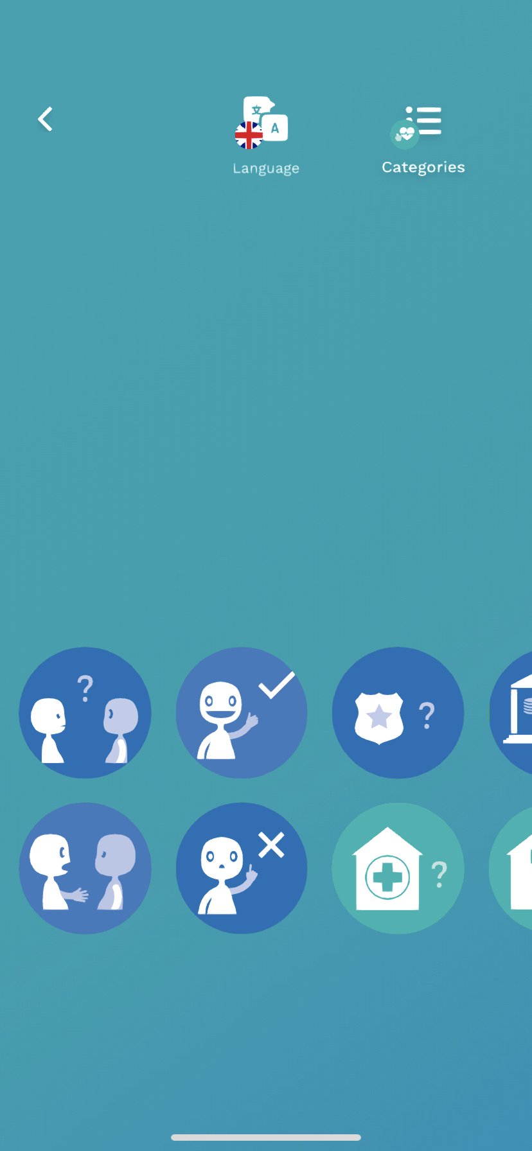
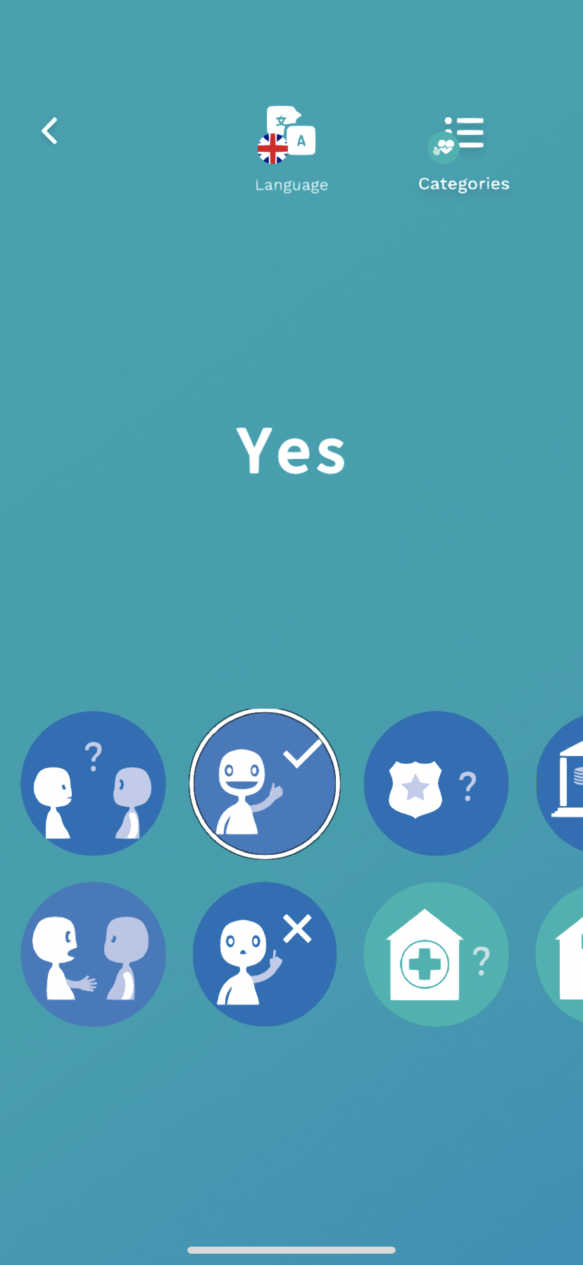

The App
Audion and visual reinforcement
Change of category and language
Language selection
Category
Selection
EPCL icon

Slide 43
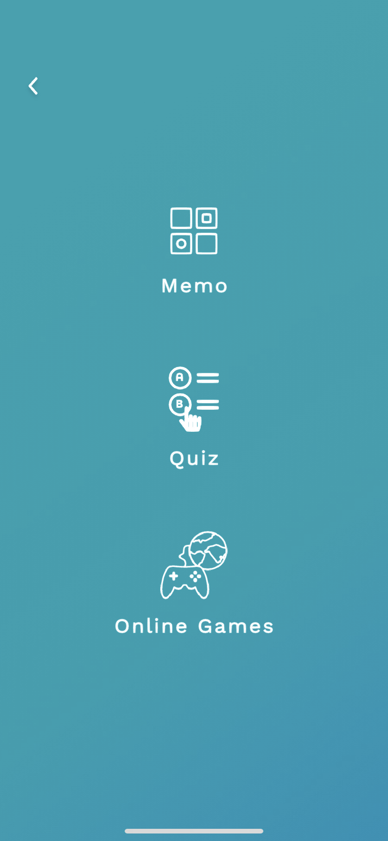
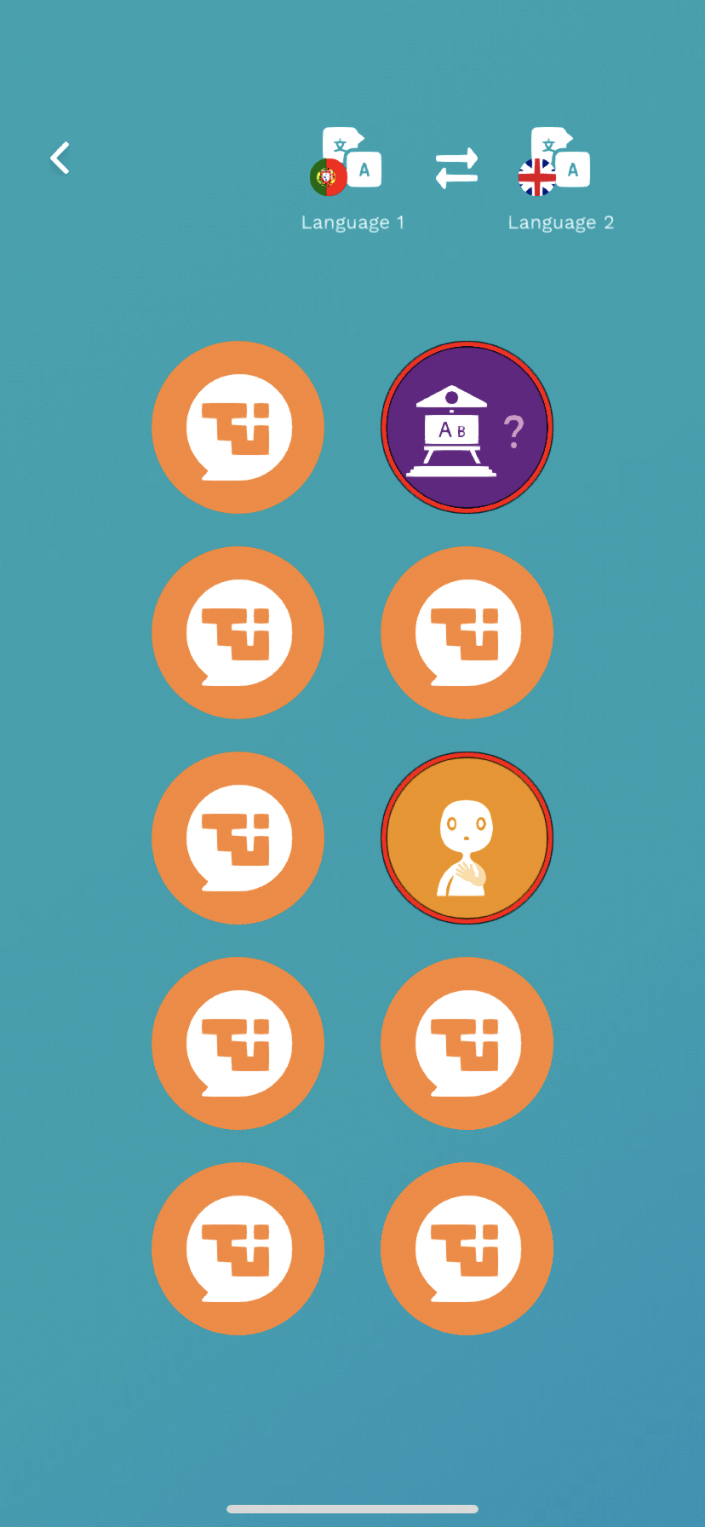
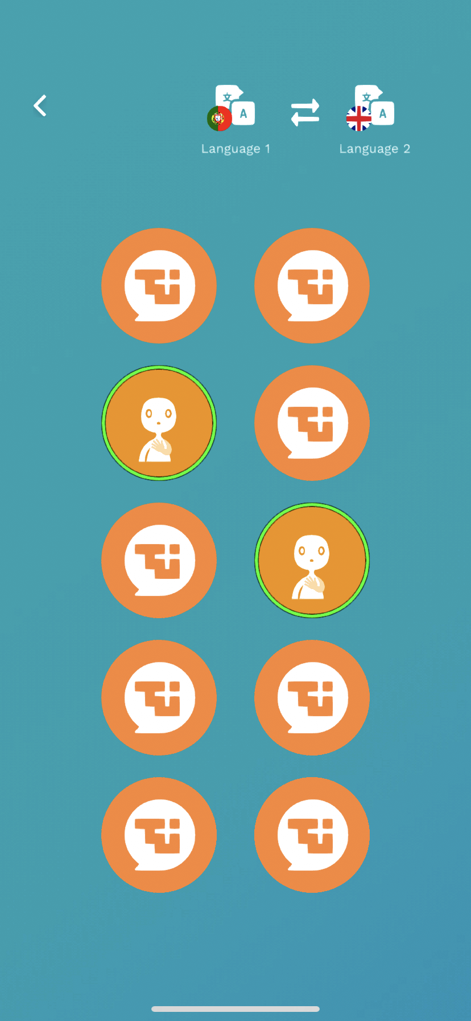
The App
Homepage
Change language
Audion and visual reinforcement

Slide 44
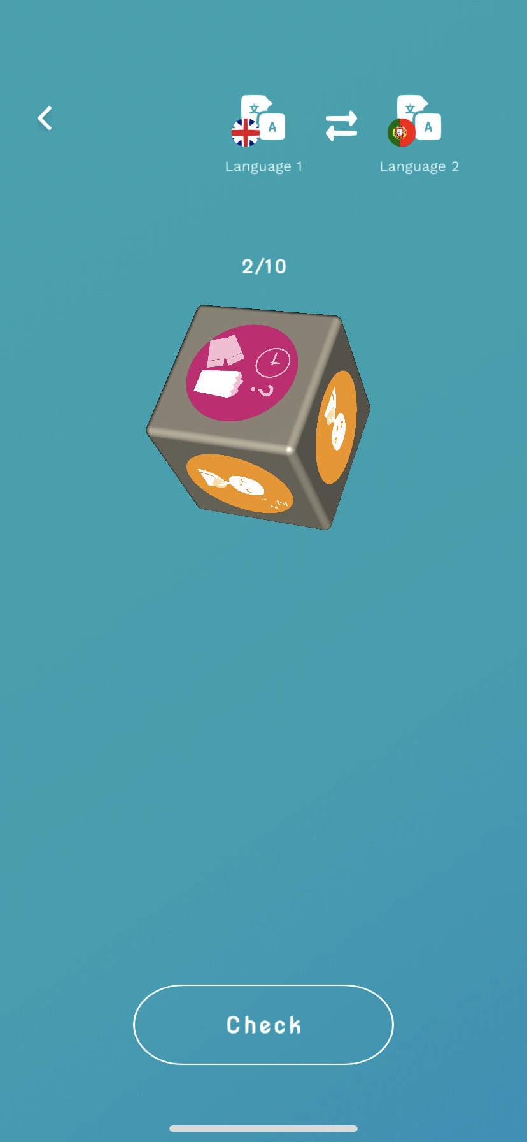
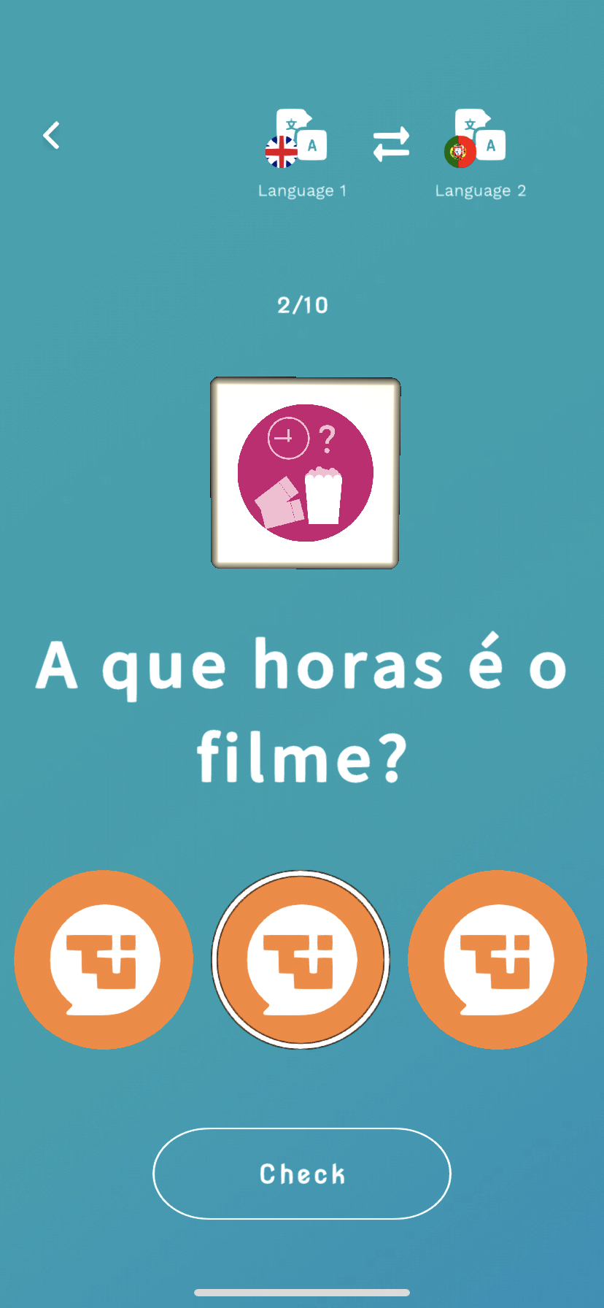
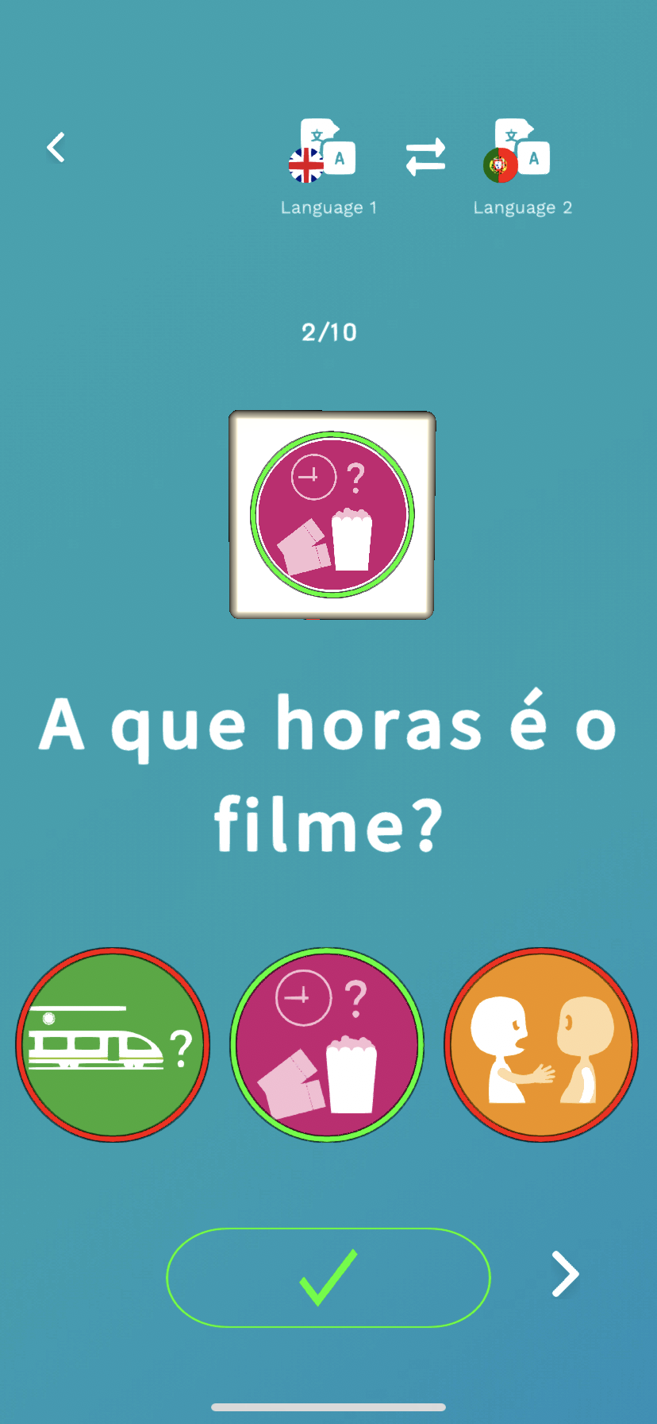
The App
Homepage
Random EPCL Pictogram
Audion and visual reinforcement
Click in the correct answer and check the result

Slide 45
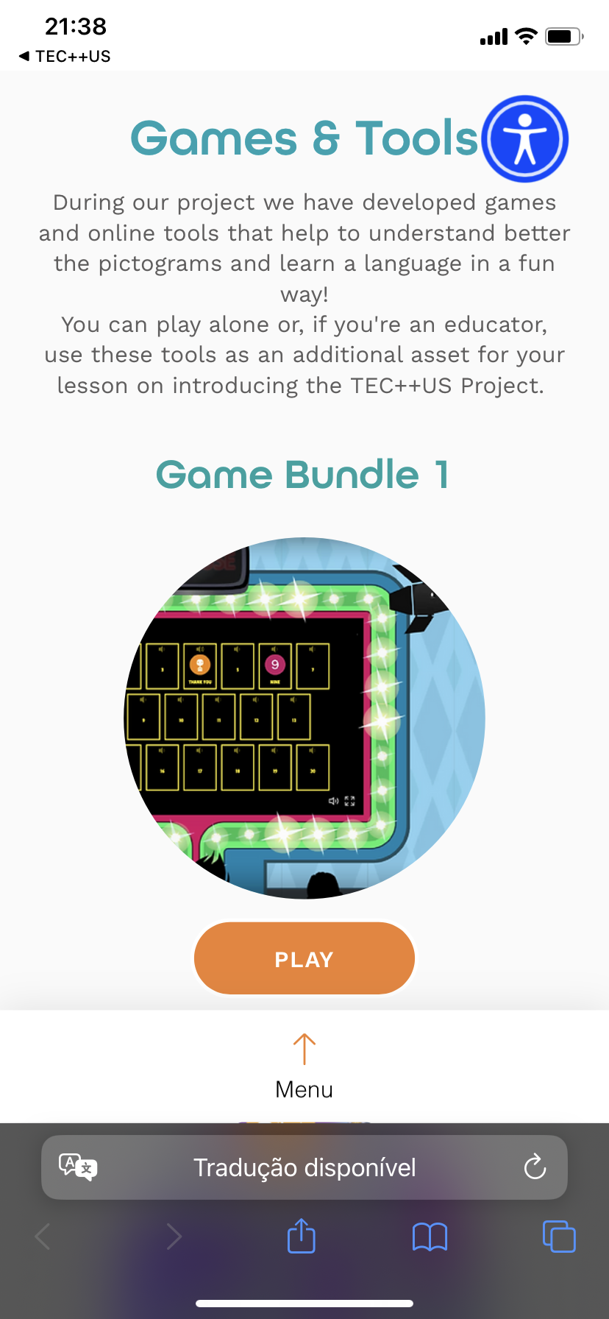
The App
Homepage
Online games that can be used to lear the EPCL and vocabulary
https://www.tec4everyone2us.eu/c%C3%B3pia-coming-soon

Slide 46
Group work – 1h
Divided in groups try the app, the app games and the online games.
1 – Make a list of activities that can use the EPCL, the App, the App games and the online games.
2 – Make a rating of the best software to use with learners (App, App Games or Online Games).

Slide 47
Asynchronous Activity
Create a post evaluating the App materials and online materials of TEC++US 2.0.
Include some sugestions to improve the materials.

Slide 48
4. Complementary materials to the TEC++US application and activities planned for teaching with the use of augmentative and alternative learning and communication pictograms.

Slide 49
Advantages of Board Games with Pictograms
Universal Understanding: Pictograms transcend language barriers, making it easier for players of different backgrounds to understand game mechanics and rules.
Inclusive Gameplay: Pictograms create an inclusive environment, allowing players of all ages and literacy levels to participate and enjoy the game.
Visual Learning: Pictograms enhance visual learning, aiding players in grasping concepts, strategies, and objectives quickly.
Cognitive Development: Engaging with pictograms stimulates cognitive skills, such as pattern recognition, critical thinking, and problem-solving.
Accessible Education: Pictogram-based games can serve as educational tools for teaching various subjects, making learning more engaging and interactive.
Social Interaction: Board games with pictograms encourage face-to-face interaction, fostering communication and social skills among players.

Slide 50
TEC++US 2.0 Board Game
NUMBER OF PLAYERS: 2 TO 4
EQUIPMENT: GAME BOARD * ONE DICE * 4 MARKER CHIPS
OBJECTIVE: TO BE THE FIRST PLAYER OR REACH THE FINISH
SET-UP: PLACE THE BOARD IN THE CENTER OF THE PLAY AREA, WITH THE DICE NEAR IT. EACH PLAYER OR TEAM TAKES ONE MARKER CHIPS, TO BE PLACED IN THE START.
DECIDE WHO WILL THE START PALYING AND THE ORDER OF EACH PLAYER.
PLAY:
1 - EACH PLAYER TAKES A TURN TO PLAY;
2 - A PLAYER FIRST ROLLS THE DICE. THE PLAYER MUST THEN PLACE IT´S MARKER CHIPS ON THE PICTOGRAM CORREPONDENT TO THE NUMBER ROLLED IN THE DICE;
3 - THE PLAYER WILL HAVE TO SAY THE CORRECT SENTENCE OR WORK CORREPONDENT TO THE PICTOGRAM WERE IT'S MARKER CHIP LANDED;
4 - IF THE PLAYER SAYS THE CORRECT SENTENCE OR WORD IT WILL PLAY FROM WERE IT STANDS IN THE NEXT TURN, IF NOT IT WILL GET ONE HOUSE BACK IN THE GAME BOARD.
5 - THE FIRST PALYER TO ARRIVE TO THE FINISH WILL WIN THE GAME.
ALTERNATIVE FOR BEGINERS:
YOU CAN INSTALL TEC++US APP OR GO TO HTTPS://WWW.TEC4EVERYONE2US.EU TO CHECK IF THE IMAGES/WORDS AND SPEACH BEFORE ANSWERING.

Slide 51
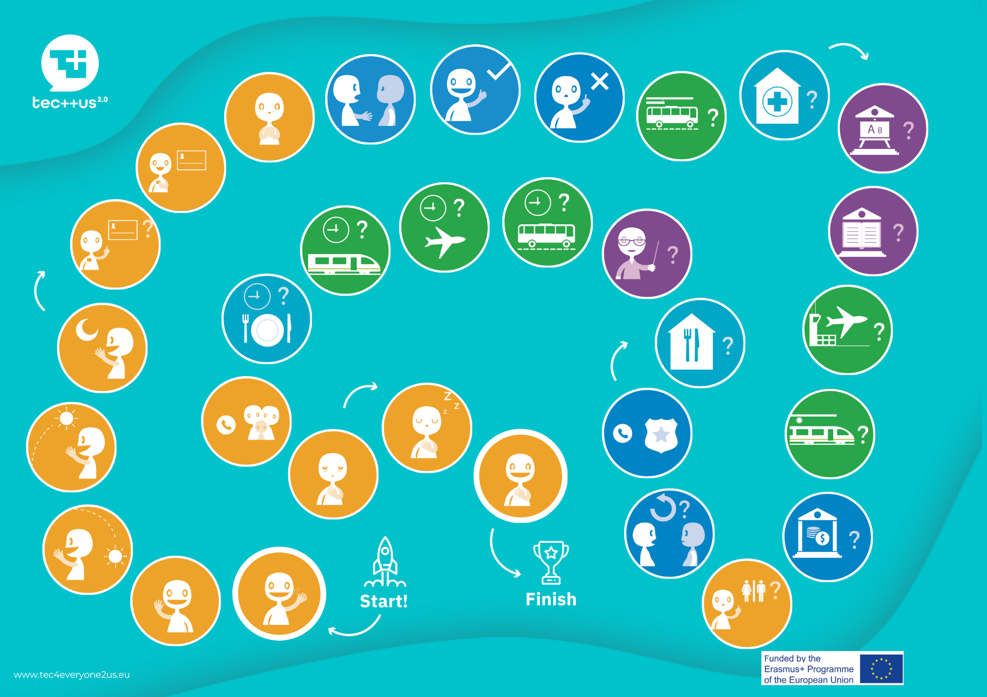
TEC++US 2.0 Board Game

Slide 52
Incorporating both board games with pictograms and online applications with pictograms and correct answers can provide a comprehensive and engaging learning experience, catering to different learning styles and preferences while promoting accessibility and interactive education.

Slide 53
Advantages of Dice Game with Pictograms on Each Face:
Clear Instructions: Pictograms on each face of the dice provide clear and intuitive instructions for gameplay, reducing confusion and ensuring a smooth gaming experience.
Quick Learning: Players can quickly understand and remember the rules associated with each pictogram, enabling faster gameplay and reducing the learning curve.
Inclusive Gameplay: Pictogram dice allow players with varying levels of literacy and language proficiency to participate and enjoy the game on equal footing.
Engaging Visuals: Colorful and engaging pictograms add a visual appeal to the game, making it more attractive and captivating for players.
Enhanced Creativity: Pictogram dice encourage creative thinking as players come up with strategies and decisions based on the visual cues provided.

Slide 54
TEC++US 2.0 Dice
INSCTRUCTIONS
Help students practice their vocabulary using the European Pictographic Language of Communication (EPCL).
Print, cut and assemble the dices.
Ask students to roll the dice(s) with the sentences/words you want them to learn.
This engaging activity is perfect for a language learning.
Complementary to the usage of the dices you can download TEC++US App or go to https://www.tec4everyone2us.eu to check the correct pronunciation and check for more activities and games using the EPCL.

Slide 55




TEC++US 2.0 Dice

Slide 56
TEC++US 2.0 Dice
By combining the advantages of dice games with pictograms on each face and online applications featuring pictograms and correct answers, players can enjoy a well-rounded and immersive learning experience that capitalizes on the strengths of both physical and digital mediums.

Slide 57
Advantages of Flashcard Game with Pictograms
Visual Learning: Pictogram flashcards facilitate visual learning, allowing players to associate concepts with images, enhancing memory retention and understanding.
Instant Recognition: Pictograms on flashcards promote quick and effortless recognition of ideas, helping players grasp information rapidly and accurately.
Versatile Education: Pictogram flashcards can cover a wide range of topics, making them versatile tools for teaching various subjects and skills.
Engagement and Interaction: Players actively engage with the pictograms, fostering interaction and participation in the learning process.
Accessible Learning: Pictogram flashcards cater to diverse learners, including those with language barriers or different learning styles, ensuring inclusivity.

Slide 58
TEC++US 2.0 Flashcards
TEC++US Flashcards for Starters. Learn words and sentences usig the European Pictographic Communication Language (EPCL) about different types of useful vocabulary needed at a low level of language. Read the sentence or look at the picture with the flashcard. You can use the TEC++US App or our website to get extra help to use the correct sentence of each pictogram by simply clicking on a botton.
Print and cut the Flashcards to practice your vocabulary. Make it a game and practice with friends.
You can install the TEC++US App or go to https://www.tec4everyone2us.eu to check the sounds of and other games using the EPCL.

Slide 59
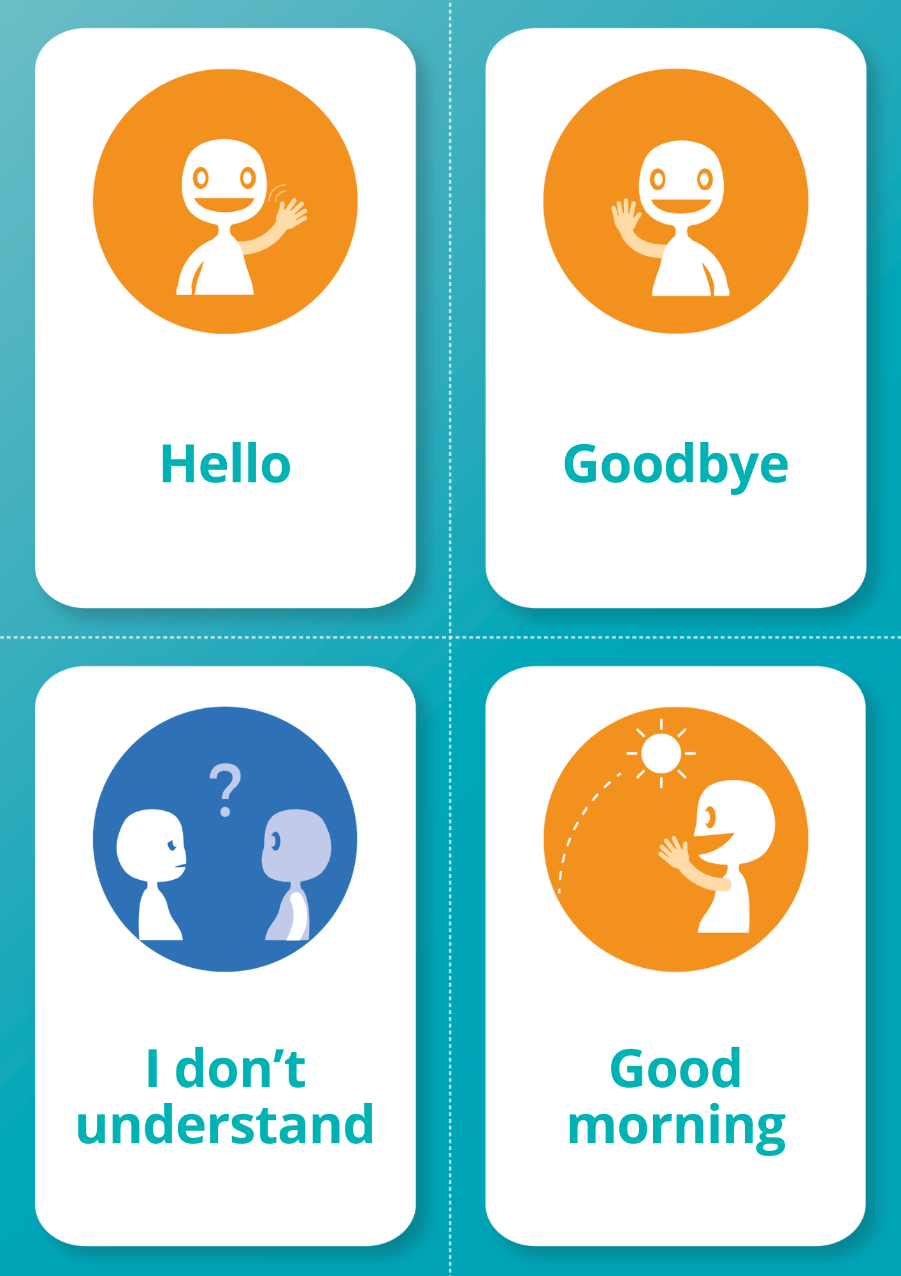
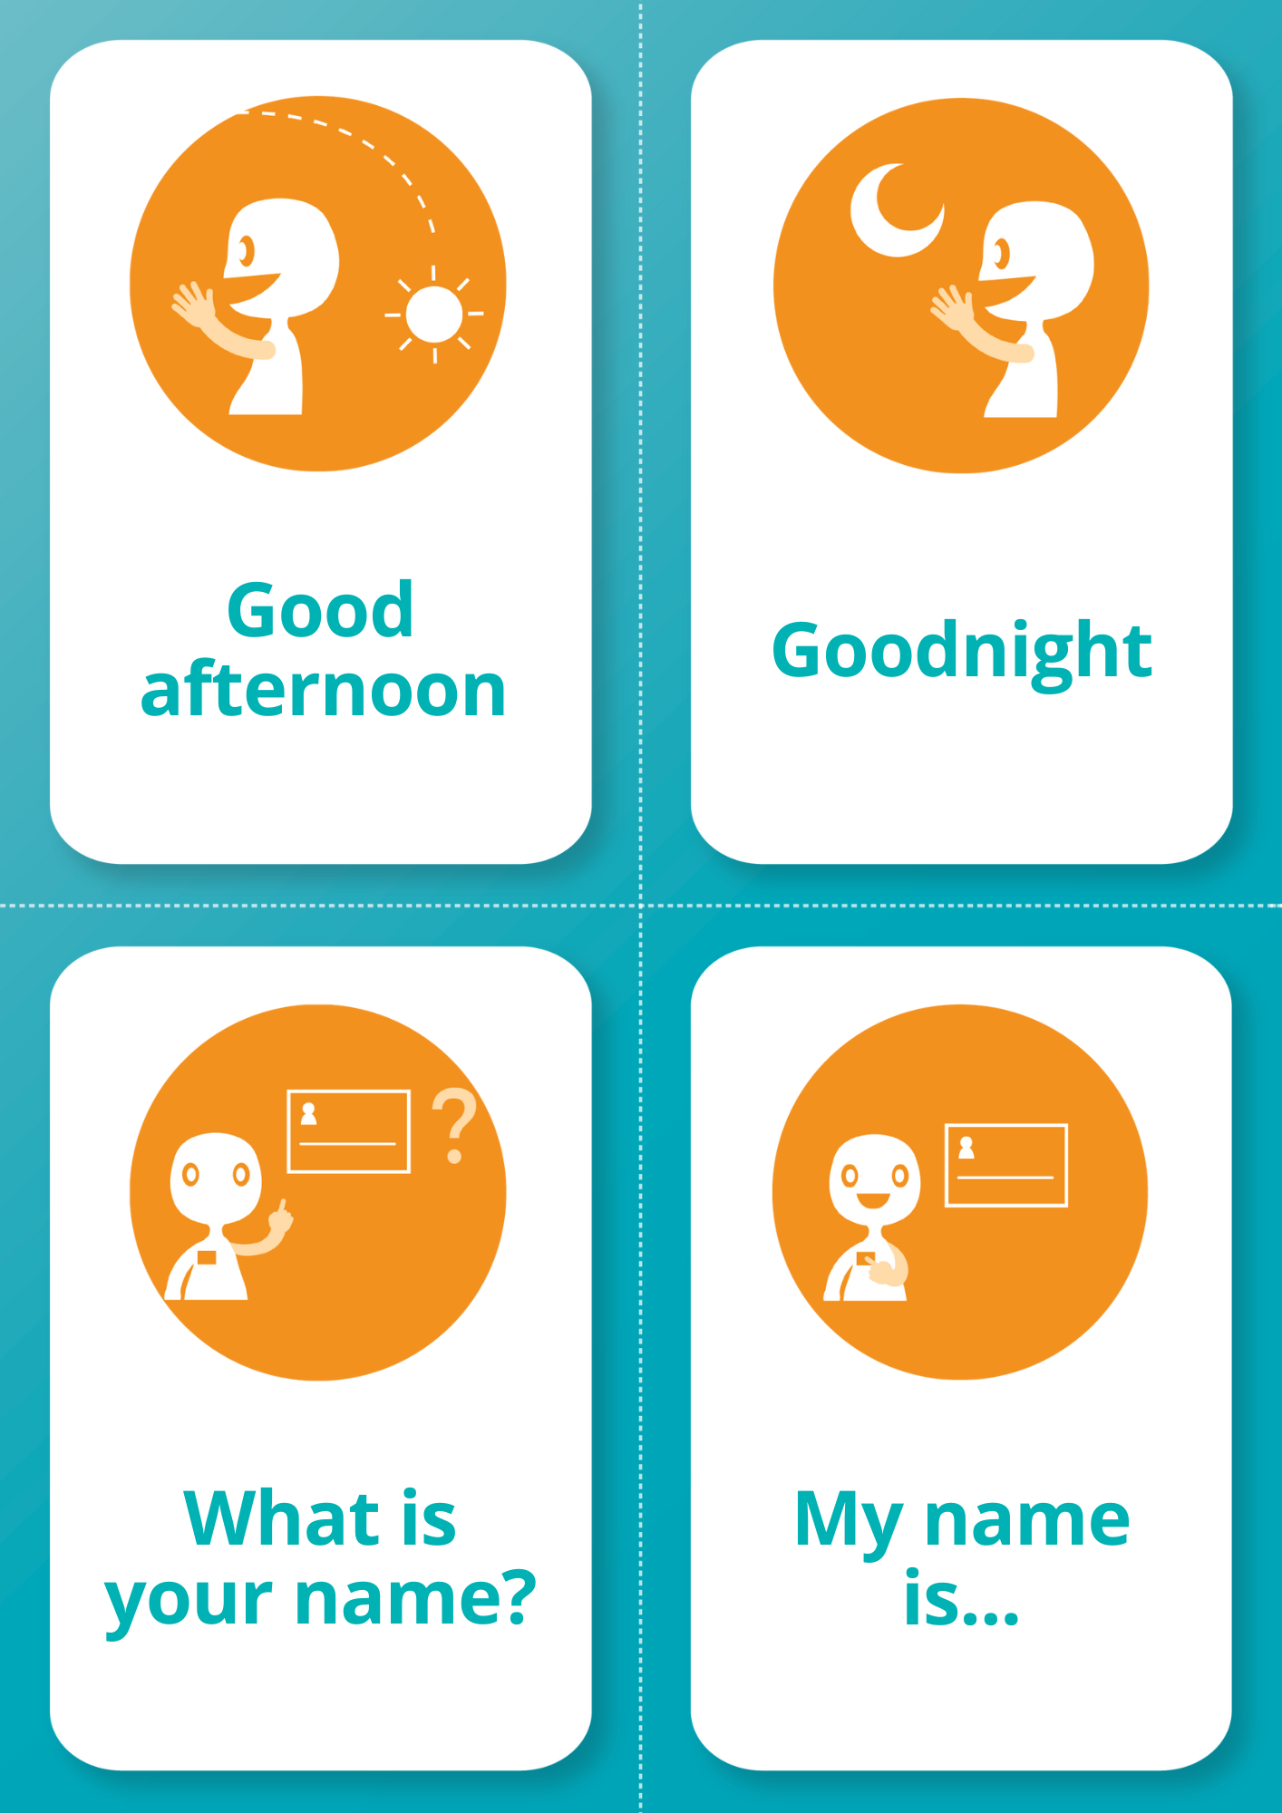
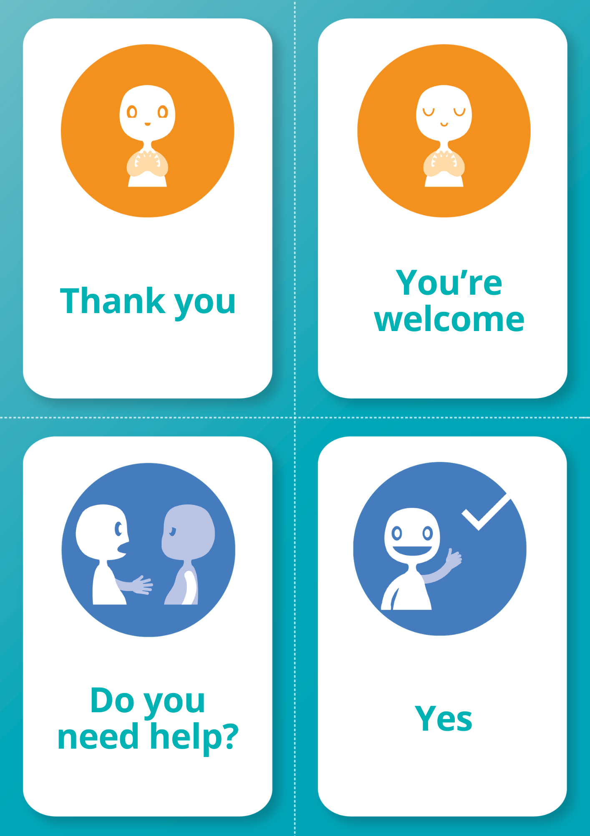
TEC++US 2.0 Flashcards

Slide 60
TEC++US 2.0 Flashcards
By combining the advantages of using pictogram flashcards and online applications with pictograms and correct answers, learners can enjoy a comprehensive and customizable learning experience that harnesses the benefits of both physical and digital tools.

Slide 61
Advantages of Domino Game with Pictograms
Intuitive Gameplay: Pictogram-based dominos offer a natural and intuitive gameplay experience, as players can easily match symbols without complex instructions.
Universal Understanding: Pictograms transcend language barriers, enabling players from diverse backgrounds to play together and enjoy the game.
Cognitive Stimulation: Engaging with pictogram dominos stimulates cognitive skills like pattern recognition, spatial reasoning, and strategic thinking.
Inclusive Entertainment: Pictogram dominos are inclusive, allowing players of all ages and language abilities to participate in a shared activity.
Social Interaction: Domino games encourage social interaction and friendly competition, fostering communication and interpersonal skills.

Slide 62
TEC++US 2.0 Dominoe
Instructions
1 - Every palyer gets seven dominoes.
2 - Decide who plays first.
3 - Lay a random domino on the table to start.
4 - Lay a matching next to the first domino (it doesen't matter wich end). Make sure like picture/word tiles are always touching.
5 - Pick from the pile if you don't have a domino that corresponds to the ones on the layout. Keep those dominoes concealed from your opponent(s).
6 -Pass if no more dominoes are left in the pile.
7 - Win the session if youre the first person to run out of dominoes.
8 - End the session if everybody passes, in wich case the winner is the person with the lowest number of dominoes.
9 - Count the score by the number of tiles remaining in your hand.
Alternative
10 - When pairing images and words the person playing has to say the correct word (sentence in mother or foreighn language).
11 - You can install TEC++US App or go to https://www.tec4everyone2us.eu to check if the images/words are correctly in pairs.

Slide 63
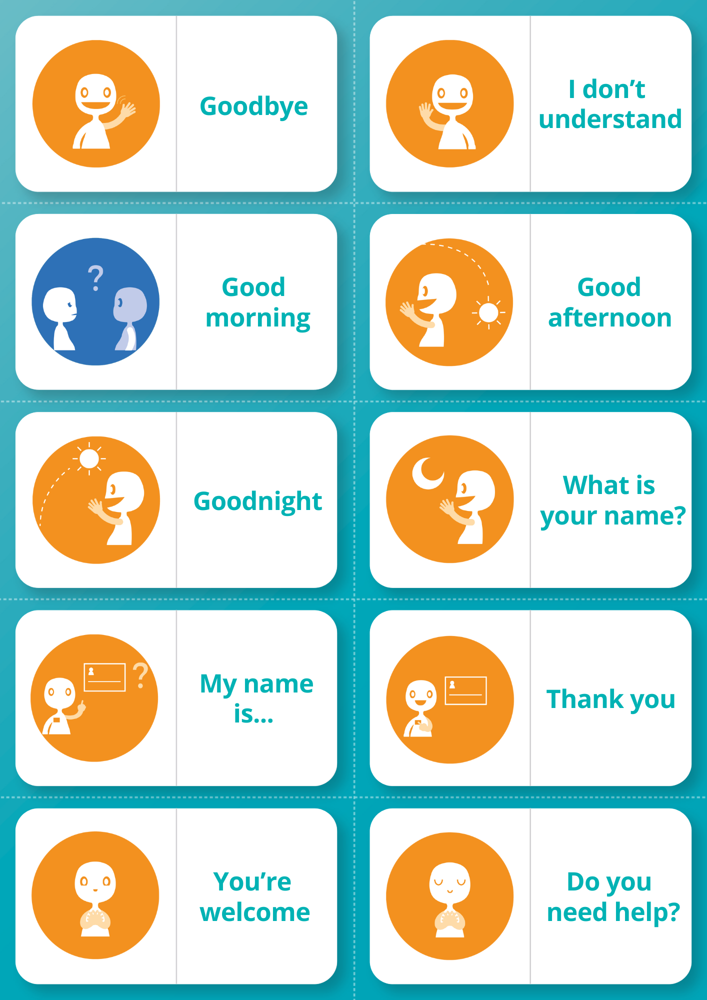
TEC++US 2.0 Dominoe

Slide 64
TEC++US 2.0 Dominoe
By combining the benefits of playing dominos with pictograms and utilizing online applications featuring pictograms and correct answers, learners can enjoy a comprehensive and interactive educational experience that leverages the strengths of both physical and digital platforms.

Slide 65
Advantages of use of games with Pictograms using TEC++US App to help in the games
Immediate Feedback: Online applications provide instant feedback on answers, helping players learn from their mistakes and improve their understanding.
Engaging Challenges: Interactive pictogram-based quizzes and puzzles offer entertaining challenges that keep players motivated to learn and participate.
Scalability: Online platforms allow for easy scalability, enabling a larger audience to access and benefit from the pictogram-based activities.
Personalized Learning: Adaptive algorithms in online applications can tailor the difficulty level of questions based on the player's performance, ensuring an optimal learning experience.
Progress Tracking: Players can track their progress over time, identifying strengths and weaknesses in their understanding of the pictograms and associated concepts.
Global Accessibility: Online applications provide access to pictogram-based learning experiences to individuals worldwide, promoting cultural exchange and diversity.
Multimedia Integration: Online platforms can incorporate multimedia elements, such as videos and animations, enhancing the overall learning experience.
Collaborative Learning: Online platforms facilitate collaborative learning, allowing players to work together to solve challenges and share insights.

Slide 66
Asynchronous Activity
Explore the games, if possible print and try to use them with the help of TEC++US 2.0 App.
Create a post evaluating the four printable games of TEC++US 2.0.
Include some sugestions to improve the materials of your feed back.

Slide 67
5. Preparation of a class activity using TEC++US materials

Slide 68
Engaging Classroom Activity with TEC++US 2.0
Group activity (1h)
Discuss in group an activity proposed using the TEC++US 2.0, used as a tool to enhance the learning experience. (30 min)
Highlight the key learning objectives that the activity aims to achieve.
Create a draft planing on the activity proposal of your group. (20 min)

Slide 69
Start preparing a presentation of a simulated practice
(1h)
Introduction (5 mins):
  Explain the concept of ecosystems and the importance of the activity.
  Briefly demonstrate how to navigate the TEC++US 2.0 app.
Group Exploration (5 mins):
  Tipe of work (grop work/individual work/exploration/...)
  Instructions to use TEC++US 2.0 to explore ecosystem-related materials.
Discussion and Sharing (5 mins):
  Share findings and insights using the TEC++US 2.0 features.
Assessment (10 mins):
  Explain final assessment using TEC++US 2.0 to gauge understanding.

Slide 70
Asynchronous Activity
Create a presentation in Power Point to be presented in the next session of the work planed and strategies used to implemente TEC++US 2.0 in Language Learning and Inclusion.
If possible implemente the activity with your students/learners and document the presentation with some images of the work done.

Slide 71
6. Presentation of works carried out

Slide 72
Group Presentations
Each group have 15 minutes to presente their Power Point.

Slide 73
Global balance
What did I learn?
What made you learn?
What is/were these lessons used for?
What matters/makes sense to share with peers?
How do I see the future? What continuity? What doubts, dilemmas, tensions?

Slide 74
Asynchronous Activity
Create a post on the training platform referring to the work and activities of this training, reflecting on the impact that the TEC++US 2.0 tools can have at a professional and pedagogical level.

Slide 75
THANK YOU!

